Slide 1
Lecture 3

Slide 2
θ
L
T
m
W_{t}
θ
W_{r}
W=mg

Slide 3
Pendulum
The forces on M are F_{g}, the tension on the string
The tangential component of F_{g} is always directed toward
This is a restoring force! Take
Then the restoring force is
θ
T
L
m
s
θ
mg
If we restrict ourselves to small angles
Which looks familiar

Slide 4
Pendulum
SHM Problem
θ
T
L
m
θ
mg
Solution

Slide 5


Slide 6
Physical Pendulum
o
Pivot
Suppose we build a pendulum by making a large solid object swing from one point.
Restoring force
Remember that
θ
d
CM
Pivot
dsin(θ)
CM
F_{g}
Then
Or
Another familiar differential EQ

Slide 7
Physical Pendulum
SHM Problem
o
Pivot
θ
d
CM
dsin(θ)
F_{g}
Solution

Slide 8
Torsional Pendulum
A torsional pendulum is made by suspending a rigid body from a wire. The body rotates.
twisted wire exerts a restoring torque on the body that is proportional to the angular position (sound familiar)
Rotational version of Newton’s 2nd Law
P
Then
Physics majors and those taking PH 220 in the future, you will see a torsional pendulum again!

Slide 9
Motion of a Torsional Pendulum
P
P
θ=0
θ=θ_{max}
θ=0
θ = -θ_{max}

Slide 10
Torsional Pendulum
SHM Problem
P
Solution

Slide 11
Damped Oscillations

Slide 12
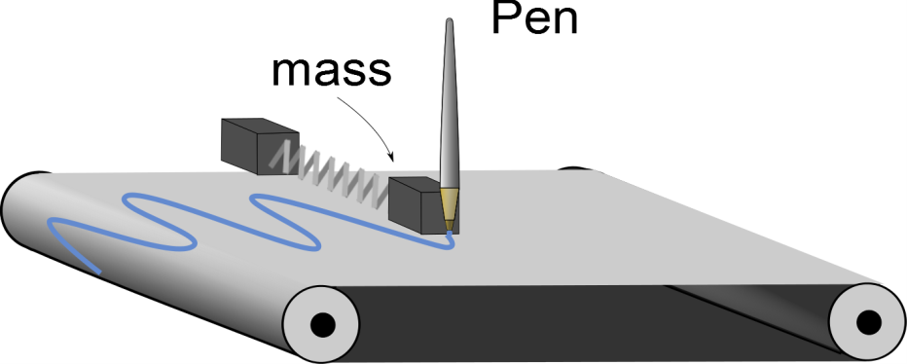
Question 6.14
I have placed a red pen in my SHM gizmo and started the chart moving. I get a strip chart that looks like the page shown to the right. What can you conclude about my oscillator system
The machine is broken
The oscillator experiences friction of some sort
The oscillator is loosing mass

Slide 13
Add a frictional force
Suppose we add in a force that is proportional to the velocity
Viscosity follows this pattern
b is the damping coefficient
Newton’s 2nd law gives
This is another differential equation. It is harder to guess its solution

Slide 14
Solution
Where
Three Cases
The retarding force is small: (bv_{max}< kA), the system oscillates, but the amplitude is smaller as as time goes on. We call this "underdamped"
The retarding force is large: (bv_{max}> kA), The system does not oscillate. we call this "overdamped." We can also say that (after we define ω_{o} below)
Case The system is critically damped (see below)

Slide 15
Example
The gray lines are the “envelope” function
They describe how the amplitude changes

Slide 16
Larger b-value

Slide 17
Even Larger b-value
Note Scale Change!
Oscillation has stopped,
Only the exponential decay is observed.
we are critically damped

Slide 18
Critical Damping
Condition for critical damping
Then
Where is the natural frequency of the system
We define
Remark When the solution in equation (damped solution) is not valid!
You will find out more about this situation in your advanced mechanics classes.

Slide 19
Forced Oscillations

Slide 21
Leg movements at the same frequency as the swing’s natural frequency make the swing go higher

Slide 22
Driving Force
Last section we added a force that killed our oscillation
Suppose we want to keep it going
Add a force
where F_{o} is a constant and where ω_{f} is the angular frequency of the driving force
This one is very hard to solve

Slide 23
Steady State
Let’s assume that we add in enough energy with the driving force that we make up for the energy lost in the damping force
Then the solution is
EXCEPT
We will drop the subscript f for convenience

Slide 24
Example
Notice that right at ω_{o} our solution gets very big

Slide 25
Resonance
To see why resonance happens, think of the velocity
And our driving force is
The rate at which work is done (power) is
if F and v are in phase, the power will be at a maximum!

Slide 26
Example
Resistive force is never really zero in real systems
It can be small
Small b
Large b

Slide 27

Remember Tacoma Narrows?
The wind gusts formed a periodic driving force that allowed a driving harmonic oscillation to form.
Since the bridge was resonant with the gust frequency, the amplitude grew until the bridge materials broke.

Slide 28
Summary
SHM along a straight line can be thought of as a projection of a uniform circular motion along a diameter of a reference circle
Pendulum
Physical Pendulum
Torsoinal Pendulum
Damped Oscillation
Forced Oscillation

